Slide 1

Transport Layer Part 5
Mark Allman
mallman@case.edu
EECS 325/425
Fall 2018
“That’s who we arrrrrrre … That’s how we rolllllll …”

Slide 2
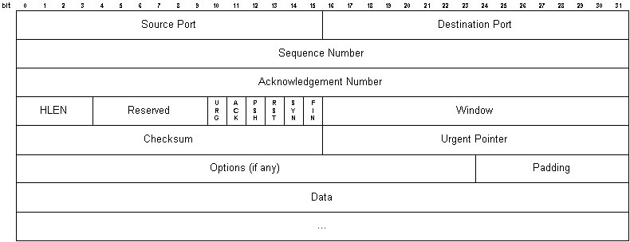
TCP Options
2

Slide 3
TCP Options
2

Slide 4
TCP Options
2

Slide 5
TCP Options
2

Slide 6
TCP Option Format
Canonical form:
3

Slide 7
TCP Option Format
Canonical form:
Type
Length
Value
3

Slide 8
TCP Option Format
Canonical form:
Type
Length
Value
8 bits
3

Slide 9
TCP Option Format
Canonical form:
Type
Length
Value
8 bits
8 bits
3

Slide 10
TCP Option Format
Canonical form:
Type
Length
Value
8 bits
8 bits
Length - 2 bytes
3

Slide 11
TCP Option Format
Abbreviated form:
4

Slide 12
TCP Option Format
Abbreviated form:
Type
Length
4

Slide 13
TCP Option Format
Abbreviated form:
Type
Length
8 bits
4

Slide 14
TCP Option Format
Abbreviated form:
Type
Length
8 bits
8 bits = 00000010
4

Slide 15
TCP Option Format
5

Slide 16
TCP Option Format
Special options:
5

Slide 17
TCP Option Format
Special options:
End of options option:
5

Slide 18
TCP Option Format
Special options:
End of options option:
Type
8 bits = 00000000
5

Slide 19
TCP Option Format
Special options:
End of options option:
Type
8 bits = 00000000
No-op option:
Type
8 bits = 00000001
5

Slide 20
TCP Option Format
6

Slide 21
TCP Option Format
Questions …
6

Slide 22
TCP Option Format
Questions …
Do we need an end of options option?
6

Slide 23
TCP Option Format
Questions …
Do we need an end of options option?
Do we need a no-op option?
6

Slide 24
TCP Option Format
Questions …
Do we need an end of options option?
Do we need a no-op option?
Why not invent a padding option that consumes the entire needed length?
6

Slide 25
TCP Option Format
Questions …
Do we need an end of options option?
Do we need a no-op option?
Why not invent a padding option that consumes the entire needed length?
Do we need a one byte option?
6

Slide 26
TCP Option Format
Questions …
Do we need an end of options option?
Do we need a no-op option?
Why not invent a padding option that consumes the entire needed length?
Do we need a one byte option?
Why have 2 byte options instead of making more special options?
6

Slide 27
General Pattern
Type / value is a design pattern of sorts in networks:
7

Slide 28
General Pattern
Type / value is a design pattern of sorts in networks:
HTTP/1.1 200 OK\r\n
Date: Thu, 27 Sep 2018 19:33:01 GMT\r\n Server: Apache/2.4.34 (Fedora)\r\n
Last-Modified: Tue, 25 Sep 2018 17:22:44 GMT\r\n ETag: “14-576b55a8e8100”\r\n
Accept-Ranges: bytes\r\n Content-Length: 20\r\n
Content-Type: text/plain; charset=UTF-8\r\n
\r\n
7

Slide 29
General Pattern
Type / value is a design pattern of sorts in networks:
HTTP/1.1 200 OK\r\n
Date: Thu, 27
Sep 2018 19:33:01
GMT\r\n
Server: Apache/2.4.34
(Fedora)\r\n
Last-Modified: Tue,
25 Sep 2018 17:22:44 GMT\r\n
ETag: “14-576b55a8e8100”\r\n Accept-Ranges: bytes\r\n Content-Length: 20\r\n
Content-Type:
\r\n
text/plain;
charset=UTF-8\r\n
Type
7

Slide 30
General Pattern
Type / value is a design pattern of sorts in networks:
HTTP/1.1 200 OK\r\n
Date: Thu, 27
Sep 2018 19:33:01
GMT\r\n
Server: Apache/2.4.34
(Fedora)\r\n
Last-Modified: Tue, 25 Sep 2018 17:22:44 GMT\r\n ETag: “14-576b55a8e8100”\r\n
Accept-Ranges: bytes\r\n Content-Length: 20\r\n
Content-Type:
\r\n
text/plain;
charset=UTF-8\r\n
Type
Value
7

